Slide 1
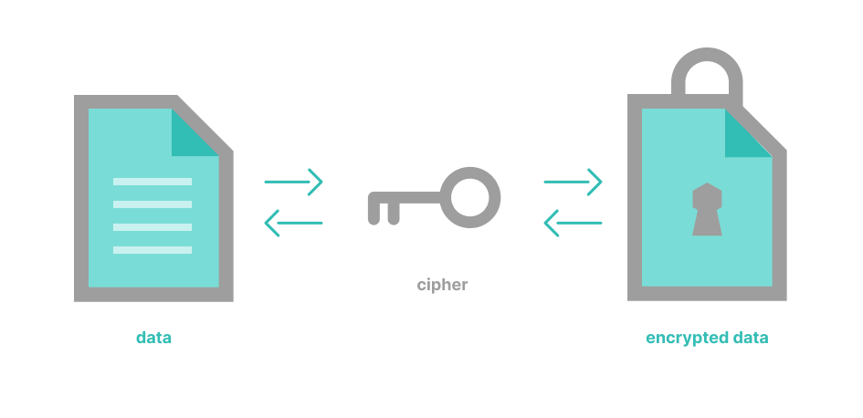
Secure Crypt: Random and Pseudo-Random Key Encryption System
Enhancing Data Security: Using Random V/S Pseudo-Random Keys for Encryption
Team Members:
Sarthak Singh (Team Leader)
Sarthak Kothiyal
Sarthak Badhani
Amit Rawat

Slide 2

Why is this project needed?
The data we share/exchange online is vulnerable to attacks and hackers can easily steal/modify our data.
A lot of encryption systems use these pseudo-random number generators to make keys but they are not always the best since they are weak and predictable.
According to a Data breach investigation Report by Verizon;
“Over 80% of breaches involve weak or stolen keys”
“A predictable key allowed hackers to decrypt millions of passwords”
“Better key generation means Stronger protection”

Slide 3

State of the Art / Current Solution
We will use Cryptographically Secure Keys to encrypt the data to help protect user-data and prevent eavesdropping.
Python’s “secret” module will be used to generate a random, highly secure key for encryption.
This way our data will be resistant to brute-force attacks and unpredictable to breach.
On the other hand, to generate the pseudo-random key, Python’s “random.seed()” can be used. But it provide algorithmic randomness and if the algorithm is known to the attackers, it will be a cake walk to gain access to our data.
In conclusion, pseudo-random keys are not ideal for encryption of data.

Slide 4
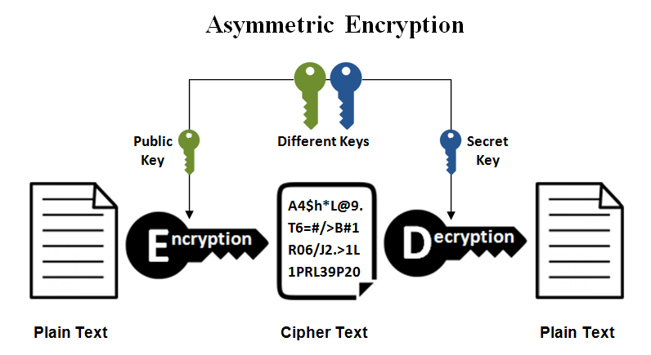


Our Solution…
Comparison of Keys
We will generate two keys:
Truly Random (using secrets module)
Pseudo-random (using random module)
Encryption and decryption of text files will be done using Fernet encryption.
Encryption method that guarantees that a message encrypted using it cannot be manipulated or read without the key.
It is part of the cryptography library in Python which is secure and easy to use.

Slide 5
System Architecture…
File Input (Generally Text File)
Generate two keys (Random & Pseudo-random)
Encryption & Decryption using Fernet Module
Security Comparison (Time taken to Brute Force)

Slide 6

Assumptions & Limitations…
Only works with text files (no images or videos).
Pseudo-random keys are for comparative analysis only (not cryptographically secure).

Slide 7
Conclusion…
Cryptographically secure keys (secrets) resists to almost all attacks, while pseudo-random keys (random) are vulnerable to brute force and seed guessing.
Always use true random keys for sensitive data.

